Slide 1
IBAMR Tutorial: Changing springs and target points

Slide 2
Simple example to move target points
Example: Moving Cylinders
A line of cylinders (forming a holey plate) is tethered to target points that translate it.
Go to the examples folder and download Example_2DMovingCylinders.zip
The relevant files are update_target_point_positions.C and update_target_point_positions.h

Slide 3
From IBAMR FAQ
There is a routine (update_target_point_positions) that loops over the local IB points (i.e., the IB points that are "local to the processor"). The pseudo-code is roughly:
for each local IB point { check to see if the point has a target point spec if yes: update the material properties w/that target spec }
The properties for the target points are stored in IBTargetPointForceSpec objects. Functionality has been added to the most recent IBAMR versions to simplify the code required to access these objects. In particular, for each Lagrangian (IB) point, you can do:
tbox::Pointer<T> spec = node_idx.getStashData<T>();
to get a pointer to any object of type T that is associated with the Lagrangian point.

Slide 4
update_target_positions.C
update_target_point_positions(
tbox::Pointer<hier::PatchHierarchy<NDIM> > hierarchy,
LDataManager* const l_data_manager,
const double current_time,
const double dt)
You have access to the current_time and time step (dt).
You also have access to the patch hierarchy and can get the nodes the particular processor is working on.

Slide 5
update_target_point_position example
const std::pair<int,int>& wing_lag_idxs = l_data_manager->getLagrangianStructureIndexRange(0, finest_ln);
//wing_lag_idxs.first is the first point on the wing. If you have more than one boundary, you can use this to determine which boundary you are on.
for (vector<LNode*>::iterator it = nodes.begin(); it != nodes.end(); ++it)
//loops over all of the nodes
IBTargetPointForceSpec* force_spec = node_idx->getNodeDataItem<IBTargetPointForceSpec>()
//get data from the target point, such as its position.
if (force_spec == NULL) continue;
//check if there is a target point associated with the node.
const int lag_idx = node_idx->getLagrangianIndex();
//get the Lagrangian index for that node

Slide 6
update_target_point_position example
//Depending on the version of IBAMR, you need to select one of the ways of accessing target point positions
//TinyVector<double,NDIM>& X_target = force_spec->getTargetPointPosition();
//IBTK::Vector<double,NDIM>& X_target = force_spec->getTargetPointPosition();
Point& X_target = force_spec->getTargetPointPosition();
//get the target point position since we are going to modify it.
if (current_time <= time_to_acc)
//check to see if we are in the acceleration phase of the wing.
if (wing_lag_idxs.first <= lag_idx && lag_idx < wing_lag_idxs.second)
//check to see if the node is on the first wing (it is because we only have one wing in this case).
X_target[1]+=current_time/time_to_acc*V*dt;
//determine the new position in the y-direction. We aren’t moving in the x-direction here.
else
//here we move the wing at a constant speed.

Slide 7
update_target_point_position.C continued
else
//here we move the wing at a constant speed.
if (wing_lag_idxs.first <= lag_idx && lag_idx < wing_lag_idxs.second)
//check to see if the node is on the first wing (it is because we only have one wing in this case).
X_target[1]+=V*dt;

Slide 8
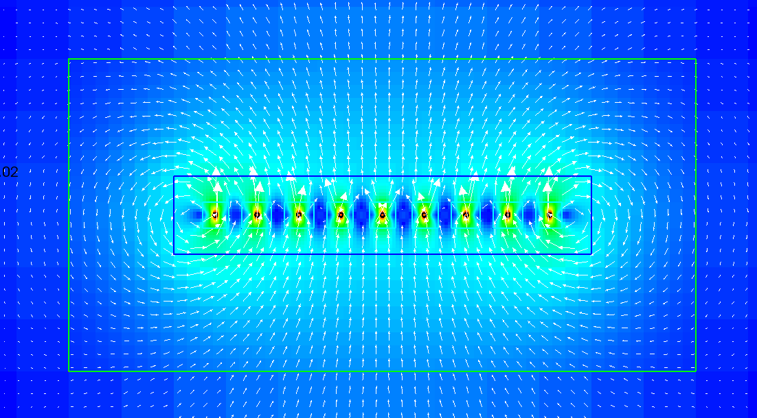
Example: Magnitude of Velocity

Slide 9
Simple example to change springs
Example_2Dsprings
The resting lengths of a 2D fiber are increased at each time step.
Go to the examples folder and download Example_2DSprings.zip
New files are update_springs.C and update_springs.h.
You also need to add these files to main.C and makefile.
The idea is similar to update_target_point_positions.

Slide 10
From IBAMR FAQ
If you use class IBStandardInitializer to initialize the Lagrangian structure and provide a ".spring" file, then the first point in each spring will have associated with it an object of type IBSpringForceSpec. You can access that object via:
tbox::Pointer<IBSpringForceSpec> spring_spec = node_idx.getStashData<IBSpringForceSpec>();
Note: Each spring is associated with ONLY ONE of the two ends of the spring. By default, this is the "master" point index, which is simply the lower of the two indices. This means that it is possible for some IB points not to have any force spec objects, even though those points might be connected to another point by a spring (or a beam). If there are not any objects of a specified type T associated with a particular node, then the function getStashData<T>() will return a null pointer. You should always check to see if the returned pointer is non-null before trying to do anything with it.

Slide 11
Spring Information
Springs now have an arbitrary number of parameters.
The convention is that the first parameter is the spring constant and the second parameter is the resting length.
To get the rest length for a particular spring, you would do spec->getParameters()[spring_number][1]

Slide 12
update_springs example
This example starts out pretty much the same as update_target_point_positions.
IBSpringForceSpec* spring_spec = node_idx->getNodeDataItem<IBSpringForceSpec>();
//get data from the spring, such as its resting length and stiffness.
if (spring_spec == NULL) continue;
//check if there is a spring associated with the node.
const int lag_idx = node_idx->getLagrangianIndex();
//get the Lagrangian index for that node
//There are two ways of doing this depending on the IBAMR version. The older way is commented.
//std::vector<double>& resting_length = spring_spec->getRestingLengths();
double resting_length = spring_spec->getParameters()[0][1];
//Get the resting lengths of the springs associated with that node. Note that you can also getStiffnesses
//double spring_stiffness = spring_spec->getParameters()[0][0];
resting_length+=0.01*dt;
//increase the resting length of each spring with speed 0.01.

Slide 13

update_springs example

Slide 14
Why multiple boundaries?
The advantage is that you can easily make them do different things.
The disadvantage is that I don’t think you can connect springs between them.
However, if you initialize boundaries in the same positions, they will stick together in those positions.
This has the effect of gluing different boundaries or parts of boundaries together.

Slide 15
Multiple boundaries example
This example considers two plates with bending and stretching stiffness that move apart as a result of moving target points.
The example presented here can be found in the Examples folder as Example_2Dmoving_plates.zip
Note that not all browsers download this file correctly. Try firefox.

Slide 16
Multiple boundaries
You can make more than one boundary in IBAMR by creating additional .spring, .vertex, .target files.
When you do this, you must add them to the input2d file (example for the new force code using plate2d_left_512, plate2d_rght_512):
IBStandardInitializer {
max_levels = MAX_LEVELS
structure_names = "plate2d_left_512" , "plate2d_rght_512"
plate2d_left_512 {
level_number = MAX_LEVELS - 1
}
plate2d_rght_512 {
level_number = MAX_LEVELS - 1
}
}

Slide 17
Getting the indices for each boundary
At the beginning of update_target_positions you will find the following:
Plate2d_left_lag_idxs.first is the first Langrangian index for the left plate.
Plate2d_left_lag_idxs.second is the last Langrangian index for the left plate.
You will need these to determine which boundary you are on.
// Find out the Lagrangian index ranges.
const std::pair<int,int>& plate2d_left_lag_idxs = l_data_manager->getLagrangianStructureIndexRange(0, finest_ln);
const std::pair<int,int>& plate2d_rght_lag_idxs = l_data_manager->getLagrangianStructureIndexRange(1, finest_ln);

Slide 18
Moving two plates
Take a look at update_target_point_positions.
This code will check to see if you are on the right plate or left plate, and then move the plate to the left or right, respectively.
if (current_time <= time_to_acc)
{
if (plate2d_left_lag_idxs.first <= lag_idx && lag_idx < plate2d_left_lag_idxs.second)
{
X_target[0]-=current_time/time_to_acc*V*dt;
}
if (plate2d_rght_lag_idxs.first <= lag_idx && lag_idx < plate2d_rght_lag_idxs.second)
{
X_target[0]+=current_time/time_to_acc*V*dt;
}
}

Slide 19
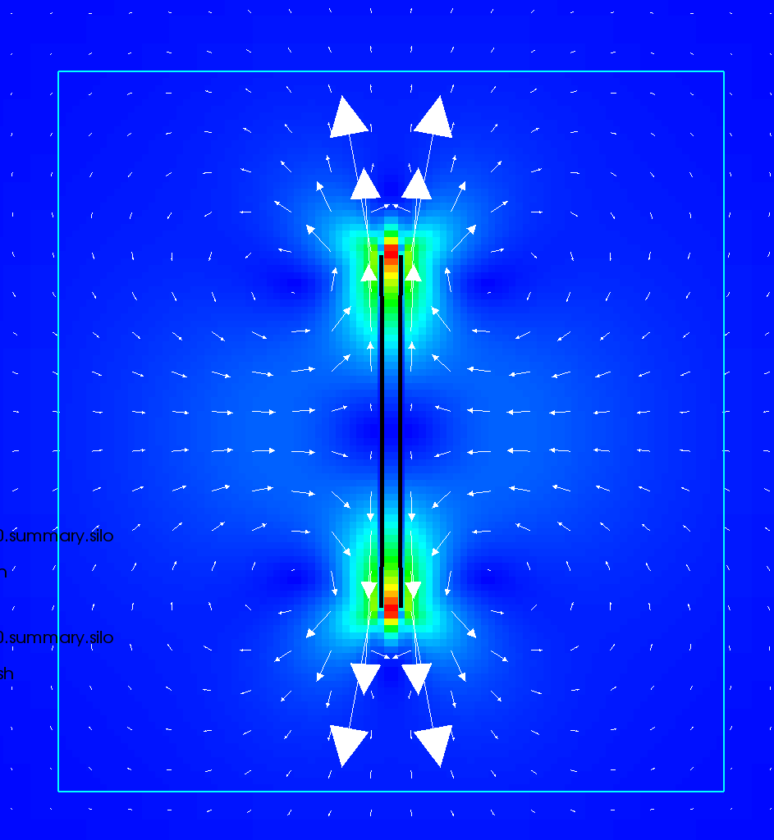
Moving plates example

Slide 20
Stretching and shrinking plates
You can comment out where you move the plates in update_target_point_positions, and remove the comment from update_springs.
The code in update_springs will make one plate stretch and the other shrink.
if (plate2d_left_lag_idxs.first <= lag_idx && lag_idx < plate2d_left_lag_idxs.second)
{
resting_length[0]+=0.01*dt;
//you could make the left plate grow and the right shrink
}
if (plate2d_rght_lag_idxs.first <= lag_idx && lag_idx < plate2d_rght_lag_idxs.second)
{
resting_length[0]-=0.01*dt;
//you could make the left plate grow and the right shrink
}

Slide 21
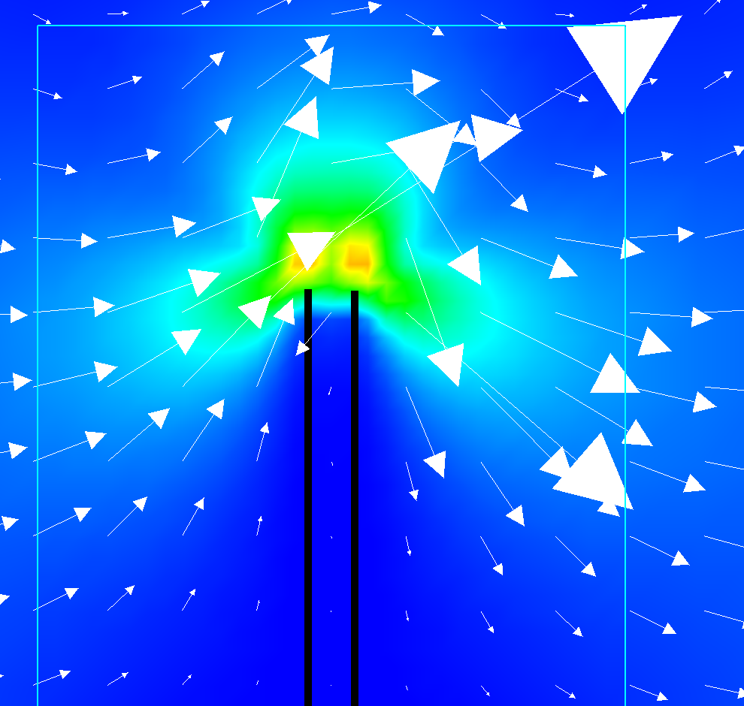
Left stretch, right shrink

Slide 22
Move and stretch?
You do not want to move the boundaries with target points and stretch/shrink the plates at the same time.
Why would this be problematic?

